Slide 1

Unit3 It is a pineapple
新疆富蕴县中学：朱玲

Slide 2
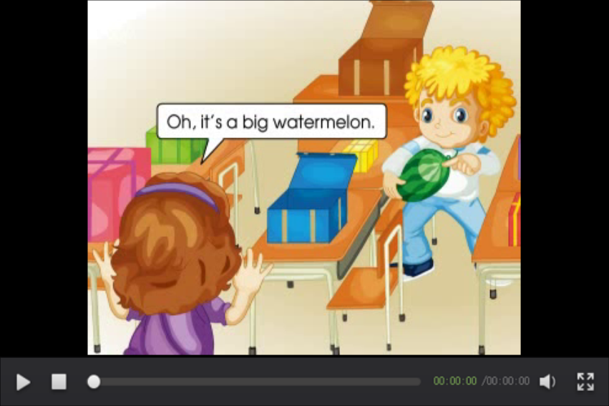
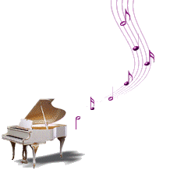

Let’s sing

Slide 3
Play a game.
What’s this in English?
It’s a /an …..

Slide 4
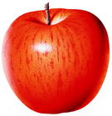
Guess
an apple

Slide 5
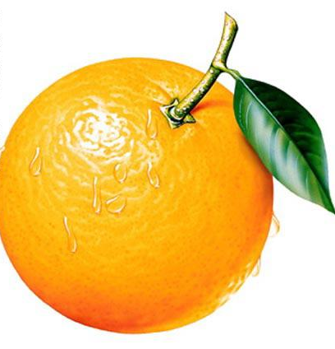

orange

Slide 6
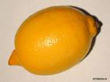
lemon

Slide 7
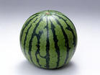
watermelon

Slide 8
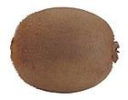
kiwifruit

Slide 9
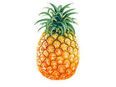
pineapple

Slide 10

potato

Slide 11
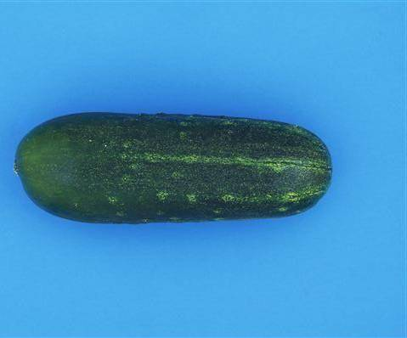
cuucumber

Slide 12

carrot

Slide 13
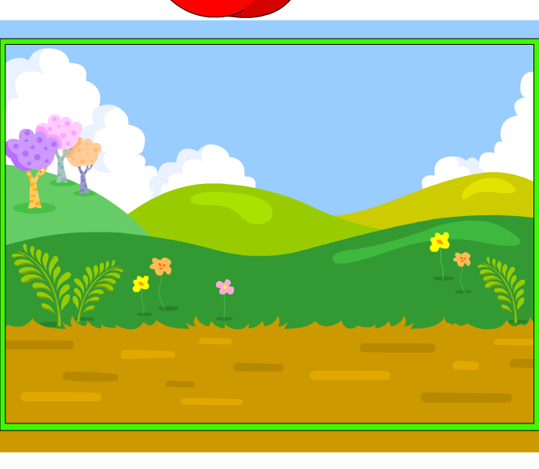
tomato

Slide 14
Question:
Guess!
What’s that in English？

Slide 15


egg
plant

Slide 16
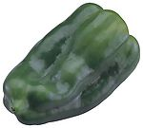
green
pepper

Slide 17
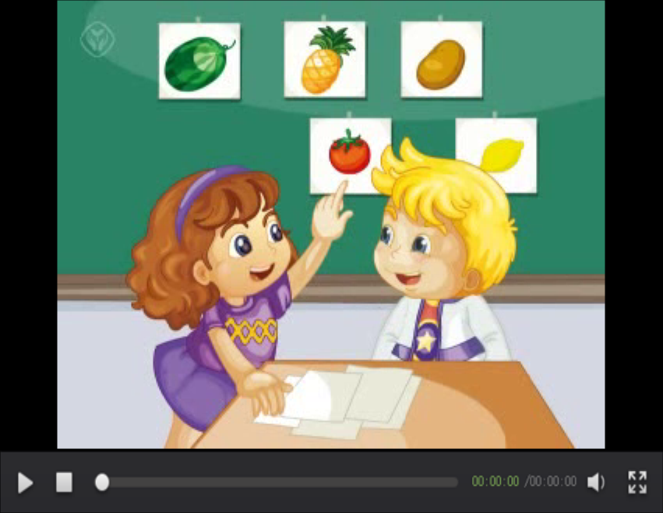

just talk

Slide 18
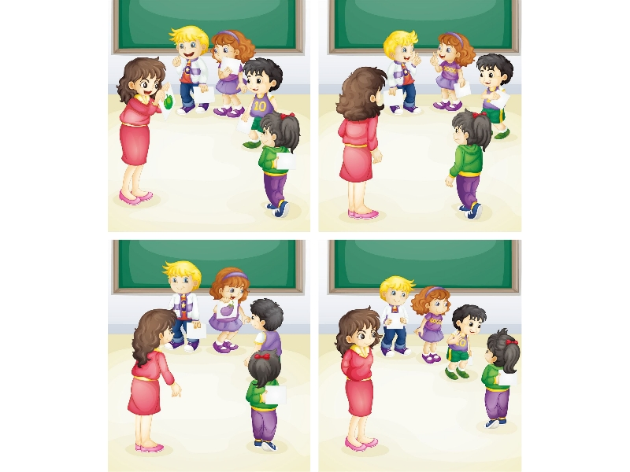
Do you like
green peppers?
Yes, I do.
It’s a green pepper.
Hi! Let’s play
a chain game.
OK!
What’s this
in English?
What’s this
in English?
It’s an
eggplant.
Do you like
eggplants?
No, I don’t.
I like tomatoes.

Slide 19

Do you like
green peppers?
Yes, I do.
It’s a green pepper.
Hi! Let’s play
a chain game.
OK!
What’s this
in English?
What’s this
in English?
It’s an
eggplant.
Do you like
eggplants?
No, I don’t.
I like tomatoes.

Slide 20

just talk
Questions:
1.Does Lisa like green peppers?
2.Does Li Yan like eggplants?

Slide 21
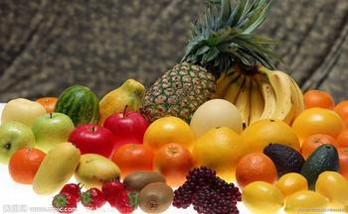
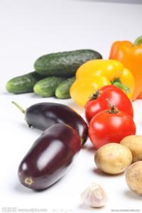
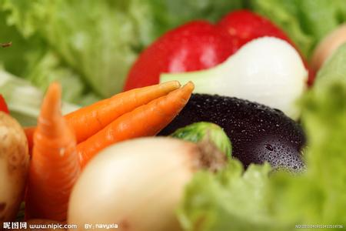
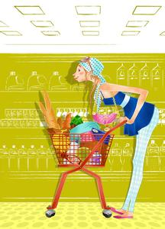
A: Hi ,……!
Let’s go to the supermarket.
B: OK！let’s go.
A: What’s this/that?
B: It’s a/an ……
A: What ‘s this/that in English ?
B: It’s a/an ……
A: Do you like ……?
B: Yes, I do./
No, I don’t.I like…
A: Oh , it’s good for us.
Let’s go shopping.

Slide 22
Choose the Correct answer(单项选择).
B
( )1. what’s that in English ? _______________
A、It’s an eggplant. B、It’s a eggplant.
A
( )2. Do you like __________?
A 、tomatoes B 、tomatos C 、tomata
c
( ) 3. Is it a _______?
A、orange carrot B、green pepper C、apple

Slide 23
完成对话（只填代号）
A: What's this in English? A: What’s that in English?
B:_______________ B: Do you like cucumbers?
A:_______________ C: Does he like cucumbers?
B: It’s a cucumber. D: It’s a watermelon.
A:_______________
B: Yes, I do.
D
A
B

Slide 24




